Slide 1
Semantic Segmentation
For Autonomous Vehicles
Surya Y
RV College of Engineering

Slide 2
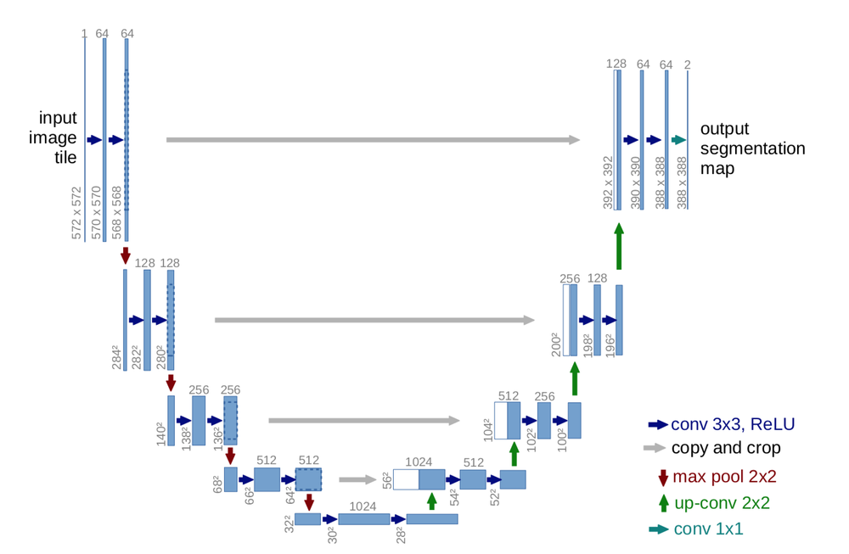
U Net : Improvement on traditional CNNs
U-Net proposes a new approach to solve the information loss problem. It proposes to send information to every upsampling layer in decoder from the corresponding down sampling layer in the encoder as can be seen in the figure above thus capturing finer information whilst also keeping the computation low. Since the layers at the beginning of the encoder would have more information they would bolster the up sampling operation of decoder by providing fine details corresponding to the input images thus improving the results a lot.

Slide 3
Methodology
Data Augmentation :
Rotation : Maximum 10 degree rotation for an image
Flip : Flipping of images left to right
Reduction in number of classes : Kmeans clustering
Mask Enhancement : Histogram Equalization
Neural Network Architecture : U-Net with 3 Convolution Blocks( 9 Million Parameters )
Training :
Optimizer : Adam
Loss : Categorical Cross Entropy
Number of Epochs* : 600-1200

Slide 4
Challenges
Computational Power : Because of Upsampling, The number of trainable parameters are doubled. Training them requires high processing power : Can be resolved with better GPU/CPU
Frame Continuity : This aspect is not considered and each image is considered as a different input
Instance Segmentation : Unet does not support instance segmentation, a separate/combined network needs to be trained
Processing capacity/Compatibility : Processing the image can take time : Using Caffe can speed up the process and improve compatibility

Slide 5
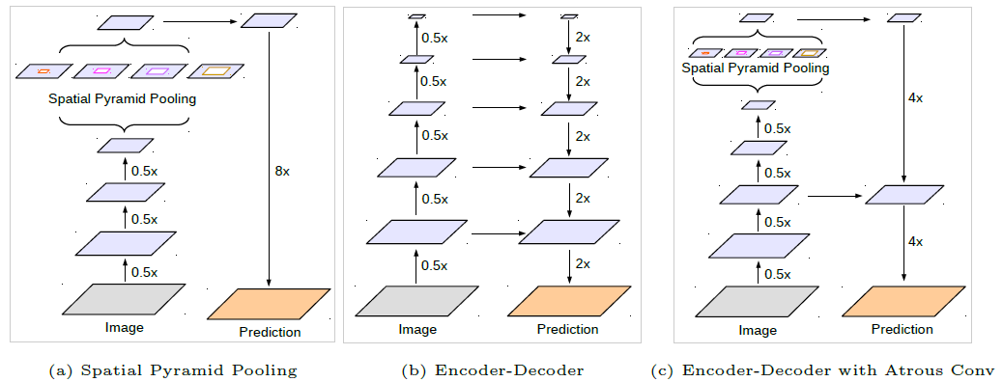
DeepLabV3 : Atrous Convolution
Deeplab from a group of researchers from Google have proposed a multitude of techniques to improve the existing results and get finer output at lower computational costs. The 3 main improvements suggested as part of the research are
1) Atrous convolutions : Dilated convolution works by increasing the size of the filter by appending zeros to fill the gap between parameters
2) Atrous Spatial Pyramidal Pooling : Spatial Pyramidal Pooling multi-scale information can be captured with a single input image
3) Conditional Random Fields usage for improving final output : Conditional Random Field operates a post-processing step and tries to improve the results produced to define shaper boundaries

Slide 6
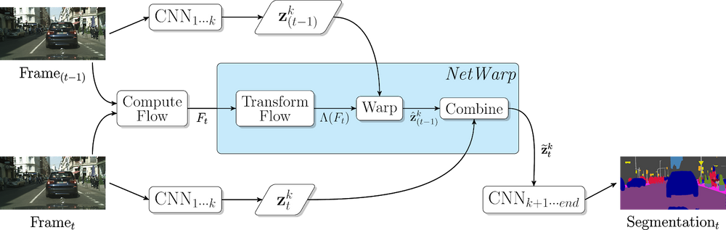
Semantic Video CNNs through Representation Warping
The key ingredient that is at play is the NetWarp module. To compute the segmentation map the optical flow between the current frame and previous frame is calculated.This value is passed through a warp module which also takes as input the feature map of an intermediate layer calculated by passing through the network. This gives a warped feature map which is then combined with the intermediate feature map of the current layer and the entire network is end to end trained

